Slide 1
New directions in science are launched by new tools much more often than by new concepts.
The effect of a concept-driven revolution is to explain old things in new ways.
The effect of a tool-driven revolution is to discover new things that have to be explained.
Freeman J. Dyson, Mathematician and Technological Visionary
What tools have shaped your research? How have they changed in the last decade?

Slide 2
The last 40 years have seen a revolution in analytical instrumentation
Examples:
4 color sequencer (Lee Hood, Lloyd Smith, Mike Hunkapillar, Tim Hunkapiller)
Electrospray ionization MS (John Fenn, Nobel Prize)
Overcoming the diffraction limit in fluorescence microscopy (Betzig, Hall, and Moerner, Nobel Prize)
Protein Structure Determination by NMR (Kurt Wuthrich, Nobel Prize)
Cryo-Electron Microscopy
Massively parallel sequencing (aka NGS) (Church, Mitra, Shendure, etc..)

Slide 3
What needs to be measured?
Who – Need methods that can determine the identity of molecules in a mixture
What – Assess function and Role
Where – Localization
Intracellular
Intercellular
When – At all points and time and under different perturbations
With Whom – Determine interactions between molecules
How much – Assess quantities
Stability – Production and Disposal

Slide 4
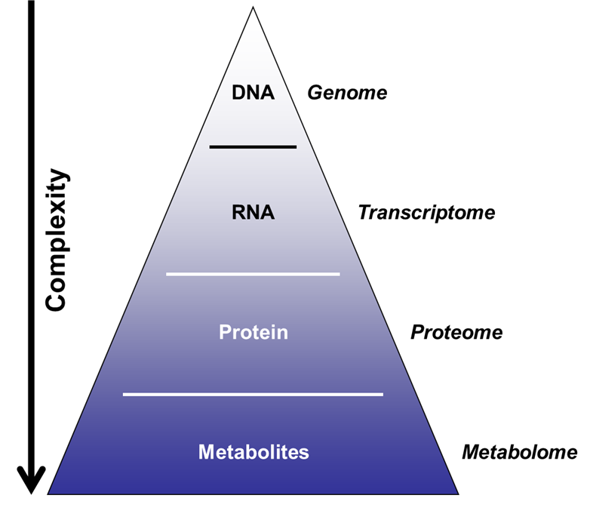
Major Biological Macromolecules Classes
Nucleic acids
DNA and RNA
Storage and transfer of genetic information
Proteins
Enzymes, hormones, antibodies, catalysts, structure, transport, motor, toxins
Carbohydrates
Energy source, structural, signaling
Lipids
Energy, compartmentalization, signaling

Slide 5
Spatial Heterogeneity
Outcome/result
Tissue sample
Bulk measurement
50 red
50 blue

Slide 6
Experimental limitations remain a challenge for spatial and low input proteomics
Spatial approach
Spatial samples are only a small fraction of the bulk aggregate samples (<20 ng of input mass)
Tissue sample
Input
material
50 red
50 blue
Throughput
Sensitivity
4

Slide 7
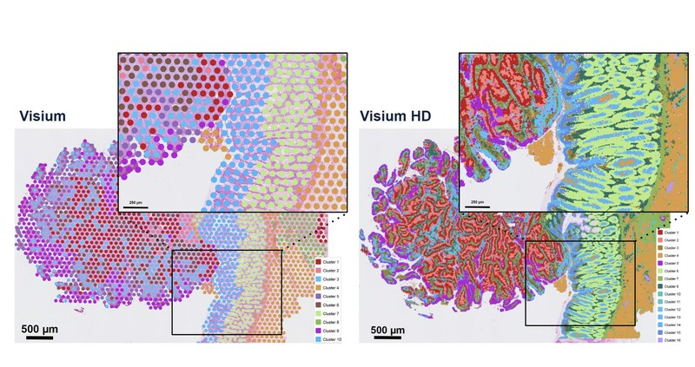
5,000 measurements at 50 µm resolution
11 million measurements at 2 µm resolution

Slide 8
Single cell measurements can provide insights into cellular heterogeneity but loses spatial information
Single cell approach
Outcome/result
Single cell measurement
Tissue sample
vs
Aggregate Bulk
50 red
50 blue
3

Slide 9
Localization can complicate quantitation

Slide 10
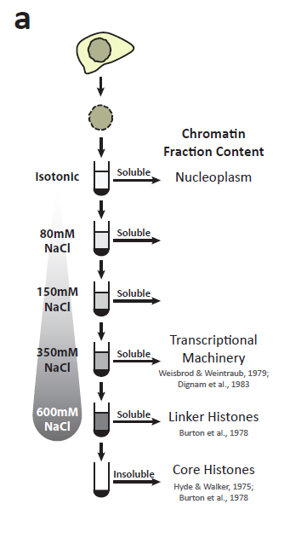
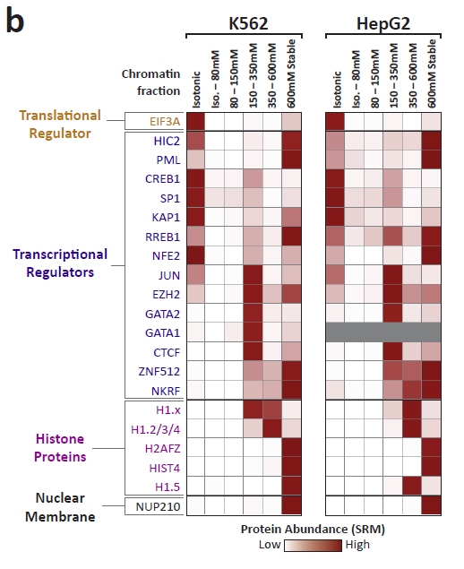
Segregation of transcription factors into discrete chromatin compartments
Data Andrew Stergachis

Slide 11
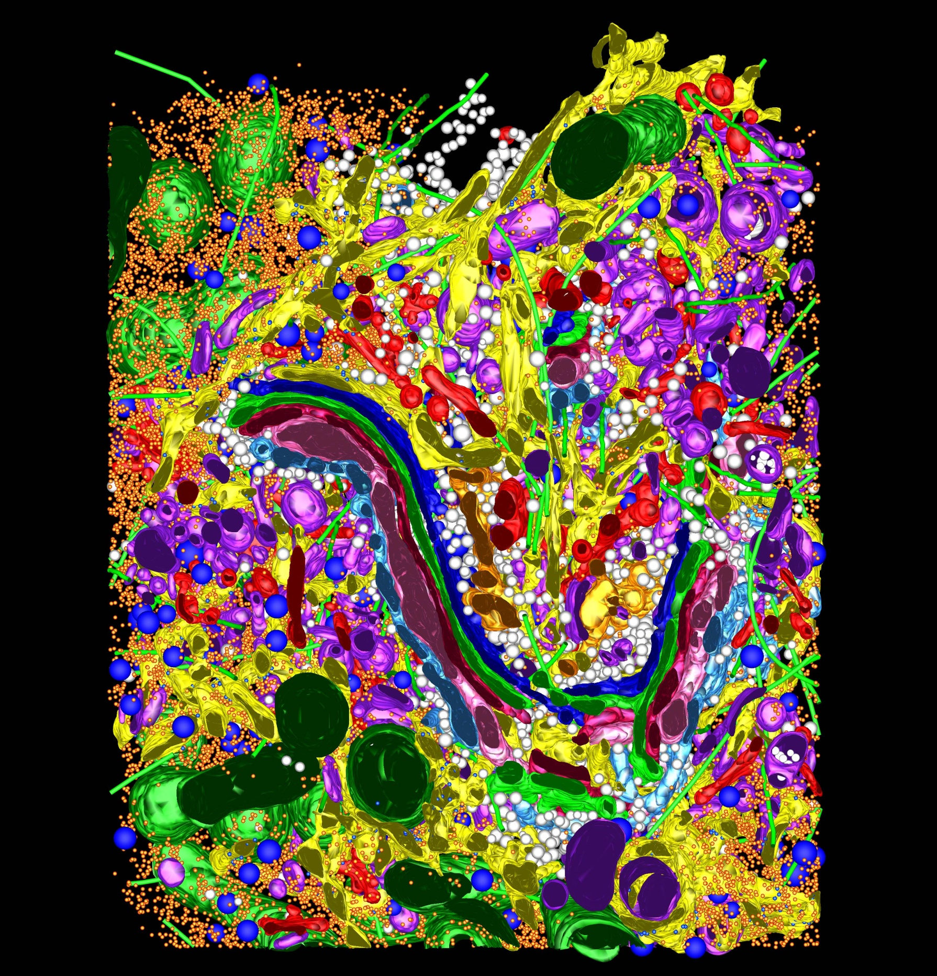

Slide 12
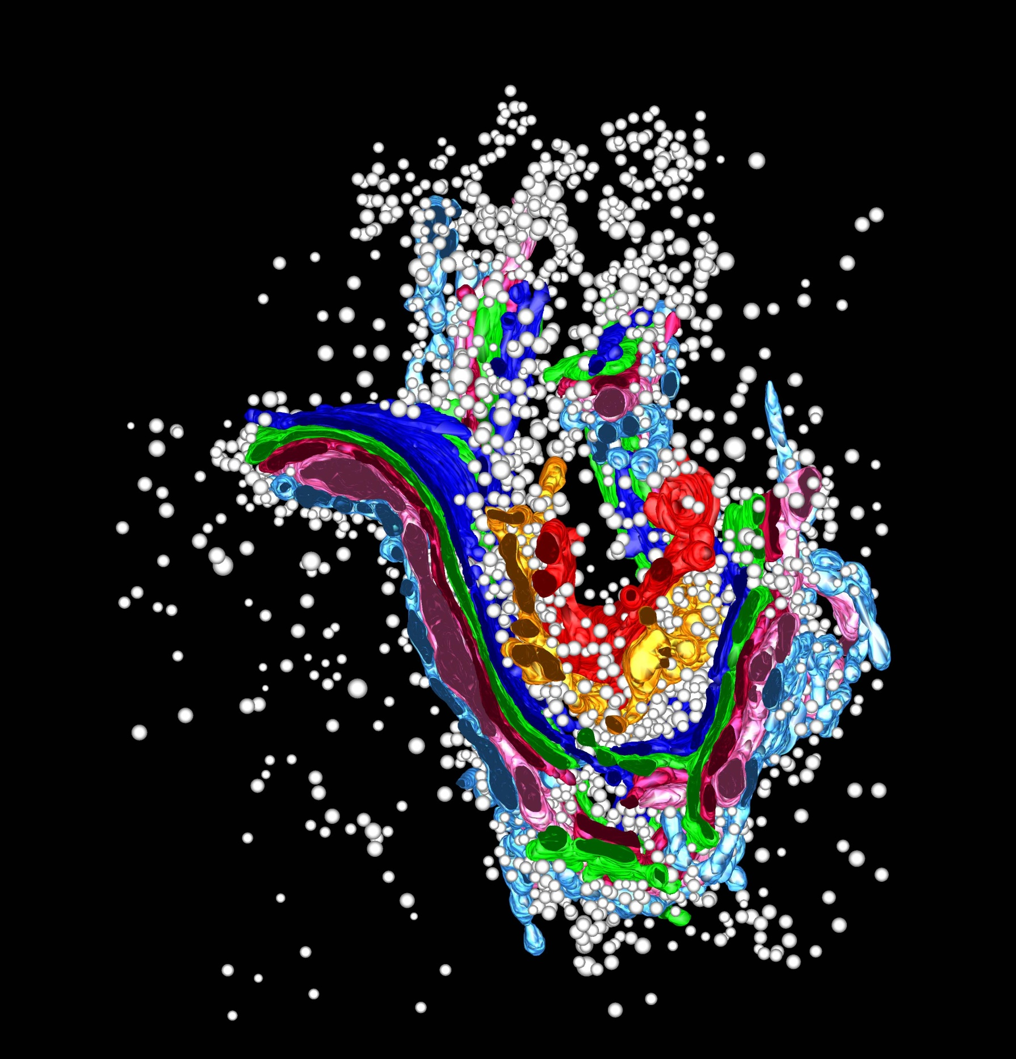

Slide 13
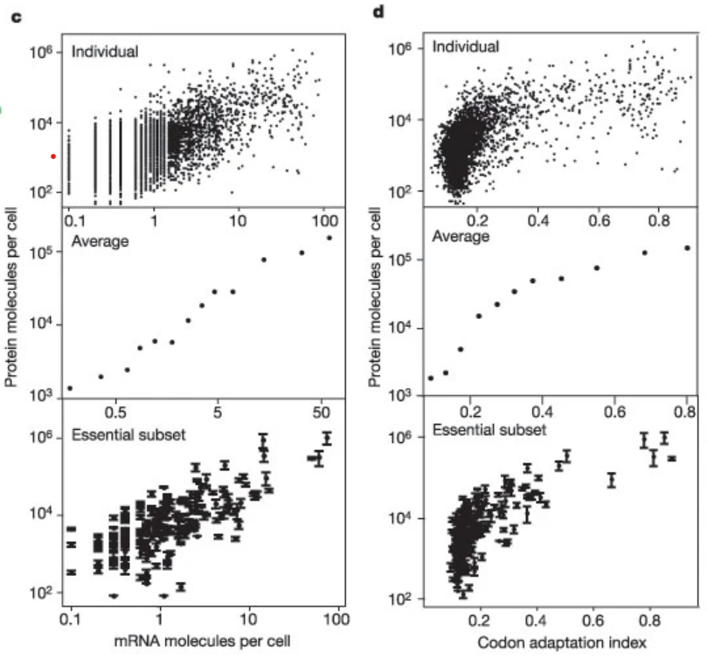
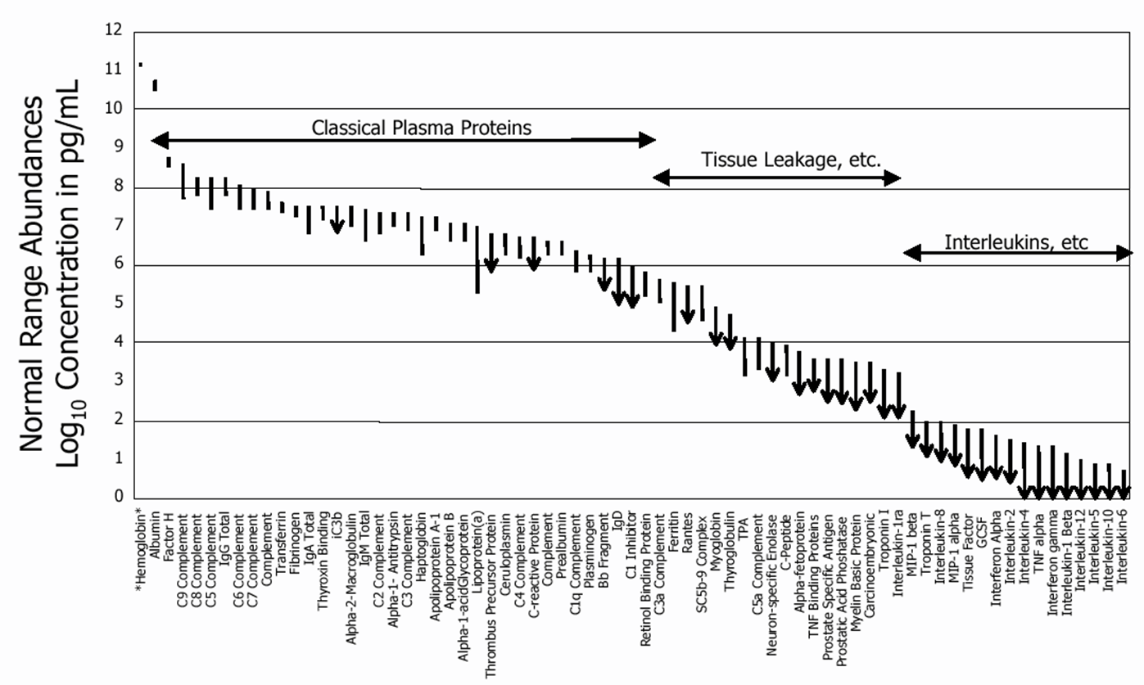
Dynamic Range
21 Proteins Represent 99% of the Blood Protein Mass
The proteome spans a dynamic range of 10^6 to 10^12
Ghaemmaghami et al, Nature 2003
Anderson and Anderson, Molecular and Cellular Proteomics 2002

Slide 14
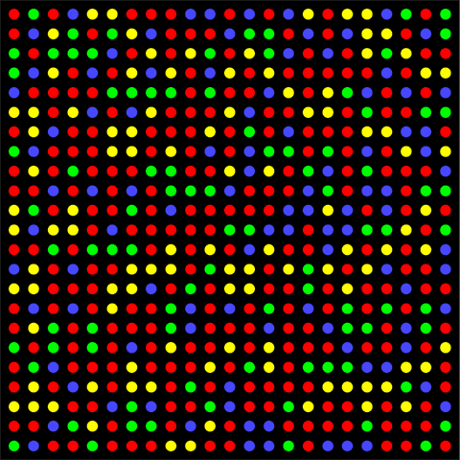
Lots and Lots of Molecules
400,000 mRNA molecules per cell = 40 million reads
Average transcript at ~5-10 copies
10,000,000,000 protein molecules per cell = 1 trillion reads
Average protein at 10⁴ to 10⁵ copies
Fluorescent wavelength = 200 – 750 nm
Leads to a practical density of ~1 µm
1 million reads: 1 mm²
100 million reads: 1 cm²
10 billion reads: 10 cm²
1 trillion reads: 1 m²
Scaling in Powers of 10 is Hard

Slide 15
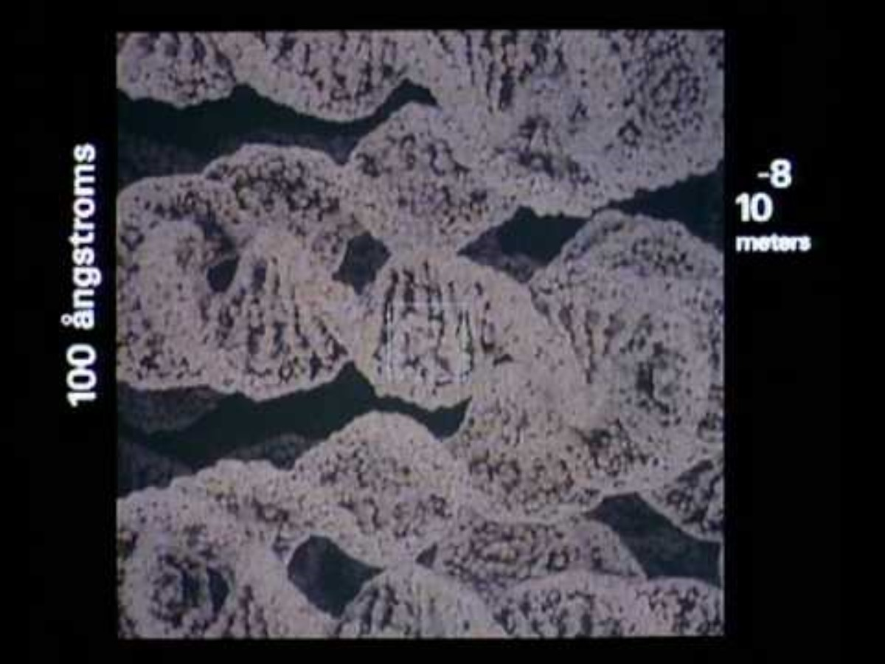

Slide 16
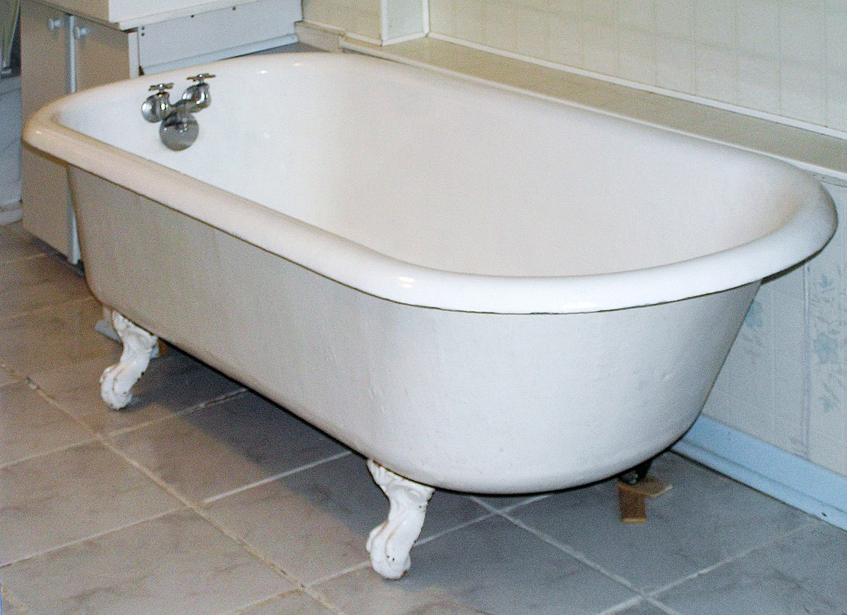
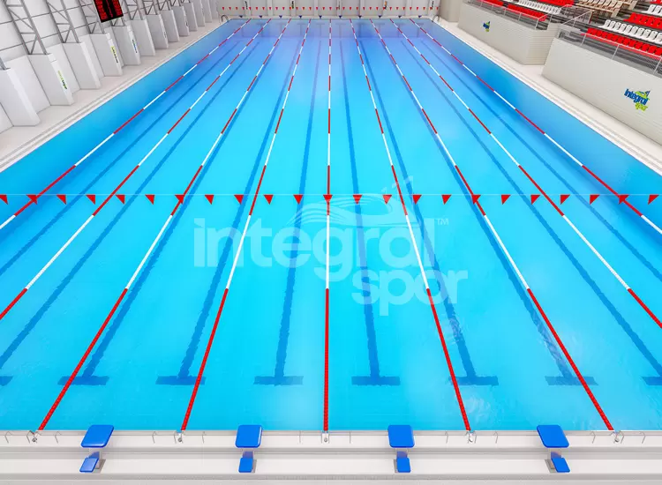
Measuring the volume of a swimming pool
80-100 liters (transcriptome)
2.5 million liters (proteome)

Slide 17
Dave Muddiman’s Analogy
Difficulty of detecting proteins in terms of distances traveled.
Assume albumin (the most abundant plasma protein) is like traveling 1 mile
Then the least abundant protein would be the equivalent of traveling around the earth at the equator ~400,000x.
What if done in a 747.
This would take about 2050 years
The fuel would cost >$80 billion
Muddiman, JPR, 2006

Slide 18
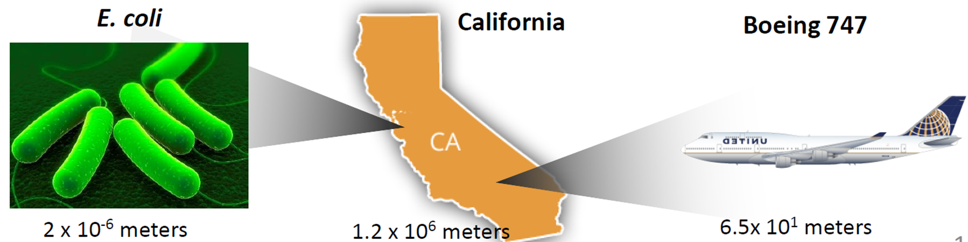
Where we need to be
Where we are at
If the most abundant protein represents the length of California, the least abundant proteins represent the length of E. coli. Most analytical methods only have 10⁴ to 10⁵ dynamic range. Representing the size of a 747.
Where we need to be to characterize the transcriptome: 4x10⁴ meters, ~marathon

